Slide 1
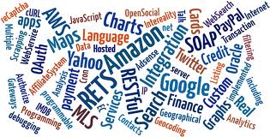
The API Economy
Kerrie Holley, IBM Fellow
IBM TJ Watson Research Center

Slide 2
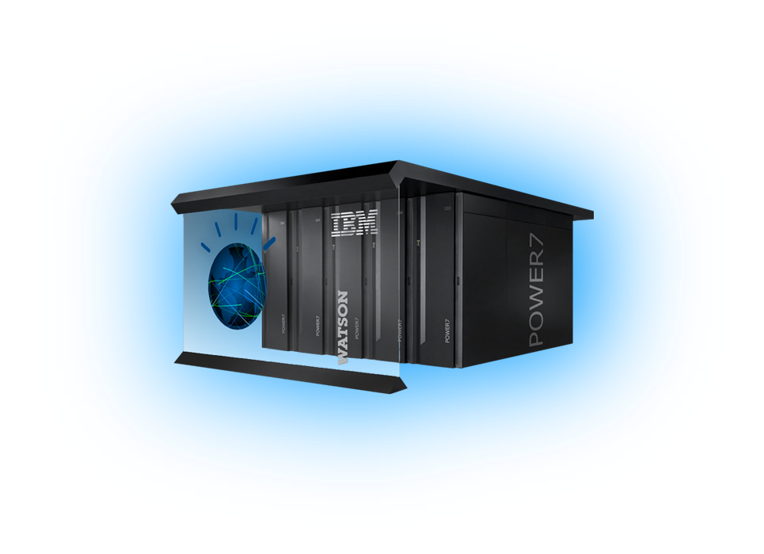


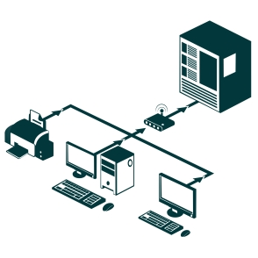
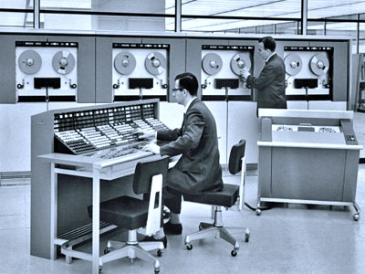
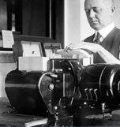
Eras of Computing
Cognitive Systems Era
Programmable Systems Era
Programmable Systems Era
Tabulating Systems Era
CAMSS (Cloud, Analytics, Mobility, Social and Security)
Tabulating Systems Era
Internet
Client-Server
Mainframe and Mini
Next Generation Portfolio Architecture and the API Economy

Slide 3
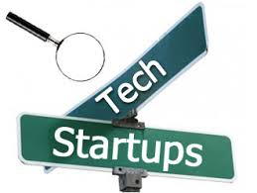

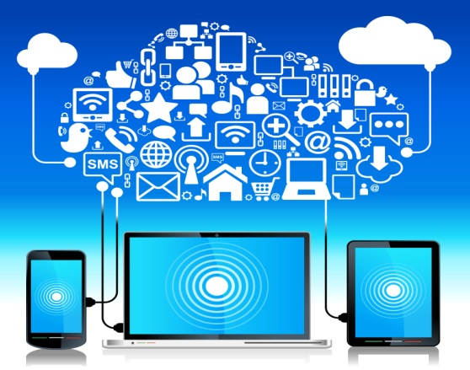
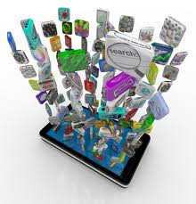
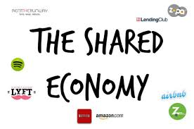
Mega Trends
Tech Startups: A Cambrian Moment
Proliferation of startups
Platformization of everything
Business ecosystems
Technology Drivers
Time to Value
Fast pace
Minimize time to value
Expectations set by new companies
New Enterprise
As a service economy
New developer
New user
Mobile - Social – Cloud - Analytics / Big Data
Collaborative Consumption
Shared, Peer-to-peer, mesh or collaborative economy
Democratization of all things
Consumerization of IT
Next Generation Portfolio Architecture and the API Economy

Slide 4
For most Major Market clients, many mission critical applications have reached the point of diminishing return
NOT SAYING that
Legacy systems are being discarded
Existing applications are not being maintained or even invested in
SAYING that
These systems, as structured, are no longer producing significant value to drive new revenue, retain customers, or acquire new customers
Diminishing Return
Many major application categories are in diminishing returns
ERP
SCM
Batch
Commerce
Value
Cumulative Investment in Applications
Next Generation Portfolio Architecture and the API Economy

Slide 5
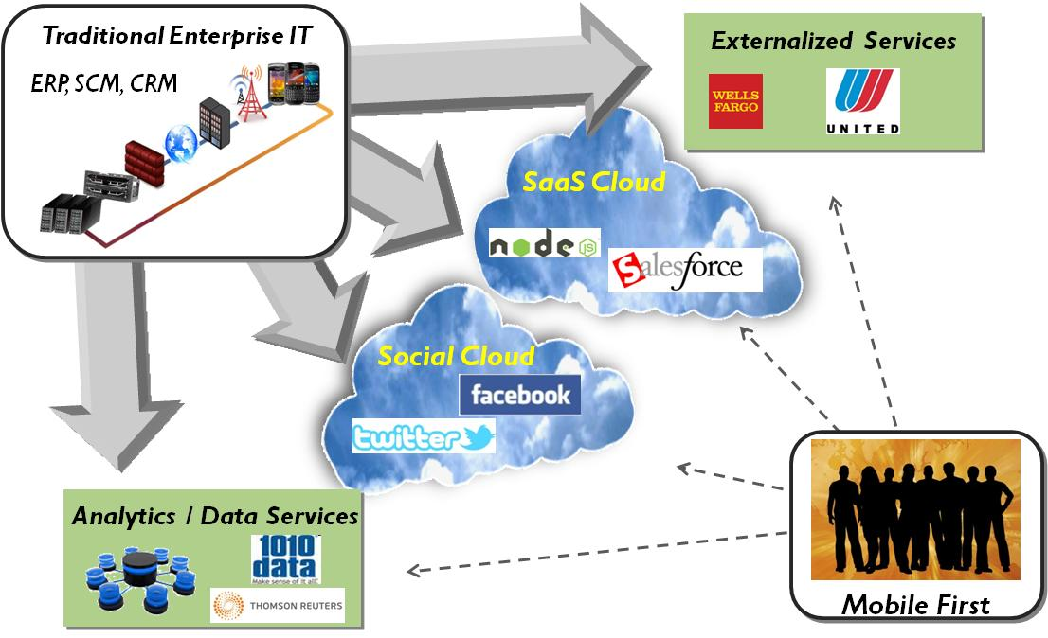
Enterprise value is coming from the extension of IT beyond the enterprise creating changing architectures and patterns
Next Generation Portfolio Architecture and the API Economy

Slide 6
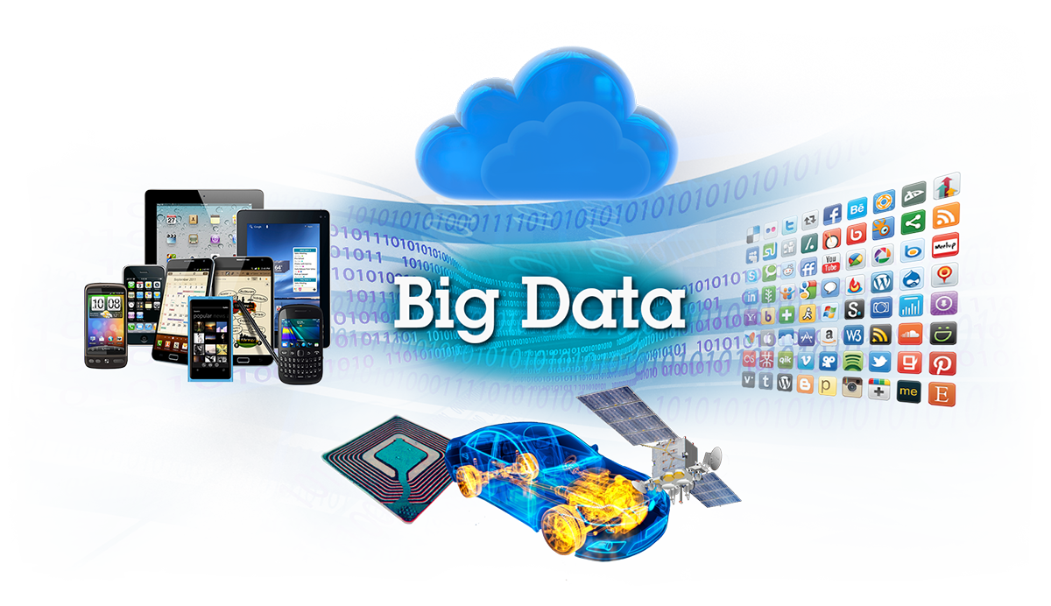
A perfect storm of sorts results, where a growing constellation of applications meets a ubiquitous network of endpoints
Cloud
Mobile
Social
Next Generation Portfolio Architecture and the API Economy

Slide 7

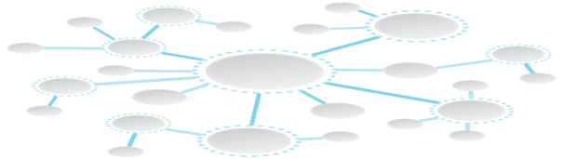


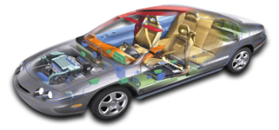

New models of product and service innovation has emerged
Systems of Record
New Modes of Engagement
Data & Transactions
App Infrastructure
Virtualized Resources
Next Generation Architecture
Expanding Interface Modalities
Big Data and Analytics
Social Networking
Data & Transaction Integrity
Smarter and Mobile Things

Slide 8
API-accessible business services made available to third-party innovators composing solutions
API
Economy
External Ecosystem
Software
as a
Service
analytics
commerce
services
Cloud Operating Environment
Marketplace
API
API
API
App
Solutions
App
API
API
Traditional Middleware-based Workloads
Platform as a
Service
Services & Composition
Patterns
API & Integration Services
Infrastructure as a Service

Slide 9

Mobility represents a new consumption pattern and enables companies to re-imagine their business models to capture new value
Context Fusion
Apps are used to perform a single task, based on the user's context (role, location, ...)
App-centric
Users increasingly demonstrate a preference for apps that are downloaded from trusted source over mobile web browsing
Apps Chained
50% of mobile sessions are composed of sequences of apps, manually "integrated" by the user
New consumption patterns place users at the center. Mobile provides a seamless experience across all channels (e.g., retail, banking, call centers).
Wearable Devices
Augmented Reality
Web
Chat
Telephone
Tablet
Social
Smart TV
Physical World
Smartphone
Next Generation Portfolio Architecture and the API Economy

Slide 10




















The API-centric, as-a-Service delivery is disrupting the consumption of business services as Cloud disrupted the IT consumption model
Integrated Business Functions
Business Solutions
API-centric Business Services
Packaged Applications
Custom Development
Long Project Planning and Development
 | As-a-service delivery
 | Composable Web
 | Short Innovation Lifecycle
API
API
API
API
API
API
The API Economy is the commercial exchange of business functions, capabilities or competencies as services using Web Application Programming Interfaces.
IBM RedGuide: Power of the API Economy
Next Generation Portfolio Architecture and the API Economy

Slide 11



Born on the cloud companies are often the proof points not the traditional incumbents
Mint.com
UK’s largest and most well known peeer-to-peer lending site
Launched in 2005
Facilitates individuals and business to accept payments through internet and mobile
Provides personal financial management service through internet and mobile.
£475 million in
peer-to-peer loans,
£190 million of that
was in 2013
Enable frictionless
payment transactions
through a
feature rich API
Process over $1B USD in
Payments since 2011
launch
By signing up for the
Mint.com’s service
where available, one also
gives access to their
various accounts
and thereby the
data on how
they spend their money

Slide 12
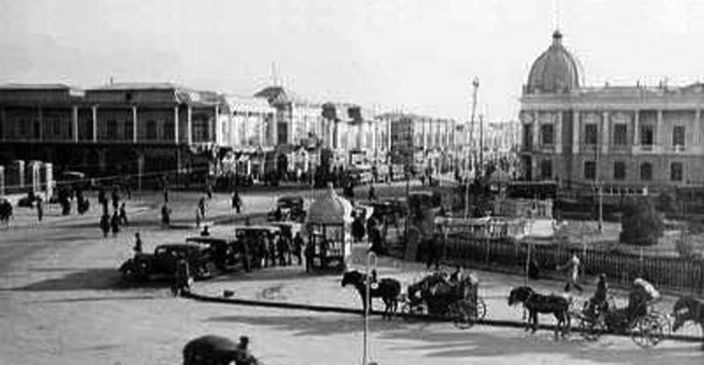
Passage to the 20th Century: Two Speed IT? Bi-Modal IT?

Slide 13
Applications and API Adoption Models
Platform Selection & Targeted Expansion
Business-as-a-Service / Built-on-the-Web Enterprise
1
2
3
4
API Discovery & Experimentation
“Re-imagine” of Core Business Proceeses
Next Generation Portfolio Architecture and the API Economy

Slide 14


Next Generation Portfolio Architecture
Before
Focus on Transactional integrity
Optimized performance
Quality of Service
Data Security
Next Generation Architecture
Focus on Agility and Rapid Scale
Workload mobility
Homogeneous standardization
Management simplicity
Core Data and Transactions
Applications Drive Infrastructure
Need for Heterogeneity
Dedicated Infrastructure Typically
IT Infrastructure Attributes
Transactional Integrity
Continuous Availability
Extreme QoS and Data Protection
Pre-allocated Capacity
Social, Mobile, User Interface
Parallel Application Model
Desire for Homogeneity
Shared Infrastructure
Infrastructure Attributes
Services Availability
Eventual Consistency
Recovery-oriented Computing
Pay as You Go Capacity
Workload Optimized & Transaction Integrity
Agility & Rapid Scale
Next Generation Portfolio Architecture and the API Economy

Slide 15
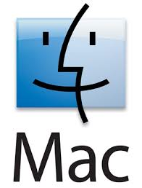
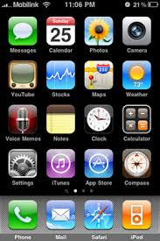

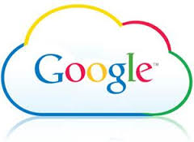




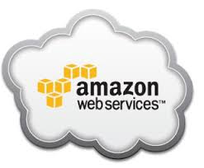


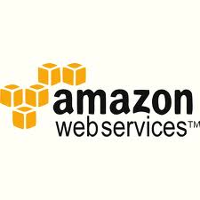


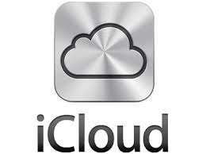

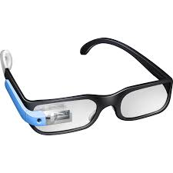


Next Generation Portfolio Architecture: Rise of Business Purpose Platforms
ATTRIBUTES OF EACH PLATFORM
Engaging customer experience
Proprietary storefront and often a marketplace
Platform SDK for developers along with developer portal
Promotes eco system of partners and developers using partner & public APIs
Recognizes that traditional channels cannot reach long tail – encourage co-innovation
Privately labeled seamlessly integrated front end for any device or Internet thing
Platform is a strategic control point and source of innovation
Next Generation Portfolio Architecture and the API Economy

Slide 16
Next Generation Portfolio Architecture: Rise of App Stores
Rise of Enterprise App Stores
Companies are establishing enterprise app stores to respond to shifting user demands and the need to understand software usage and optimize spend.
Easy access to business applications
Meets customers and employees needs for an engaging experience when it comes to accessing IT services
Empowers users to serve themselves, gives users a choice
Offers rapid fulfillment
Next Generation Portfolio Architecture and the API Economy

Slide 17
Next Generation Portfolio Architecture: SaaS Model
 | New | Different
Packaging and Pricing |  | X
Terms & Conditions (e.g., ToS) |  | X
Support (e.g., how to) |  | X
Services (e.g., onboarding) |  | X
Education |  | X
Geographic Applicability |  | X
Deployment or Client Success | X
DevOps | X
IT Operations (e.g., HA or DR) | X
Offering Constraints | X
Next Generation Portfolio Architecture and the API Economy

Slide 18


Service Oriented Architecture (SOA) and APIs
SOA Project
Today
How Do
I Get Here?
Next Generation Portfolio Architecture and the API Economy

Slide 19


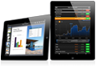
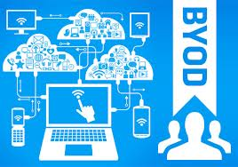
Summary: New User and App / API Economy has emerged
New user: fundamental Shifts in Devices and Usage
PC → Mobile
Search → Social
Traveling Heavy → Traveling Light
Minimal Insight → Contextual
Standard Interfaces → Imagination of User Interfaces
Application economy of the enterprise is changing: bring your own applications, data and device to the enterprise
Unaware → Incorporated Location Services
“Toy Apps” → Business Level Capabilities
Monolithic applications → Mobile Self-Service Marketplaces
Next Generation Portfolio Architecture and the API Economy

Slide 20
Summary: New User and App / API Economy has emerged
New user: fundamental Shifts in Devices and Usage
PC → Mobile
Search → Social
Traveling Heavy → Traveling Light
Minimal Insight → Contextual
Standard Interfaces → Imagination of User Interfaces
Application economy of the enterprise is changing: bring your own applications, data and device to the enterprise
Unaware → Incorporated Location Services
“Toy Apps” → Business Level Capabilities
Monolithic applications → Mobile Self-Service Marketplaces
Next Generation Portfolio Architecture and the API Economy

Slide 21








Summary: A new developer has emerged in the enterprise
The new developer is taking control over the corporation with Open Source
Prosumers are becoming the newest developers
The new developer is API driven
APIs are changing the face of development and the way products and services are delivered
Create exposure and revenue
Foster new affiliate and distribution models
Allow companies to open their resources in a secure and controlled way
Create near real time access to cross division resources
Next Generation Portfolio Architecture and the API Economy

Slide 22





Questions?
Questions? :
Kerrie holley ; klholley@us.ibm.com
twitter.com/kerrieh
http://www.facebook.com/KerrieHolleyIBM
http://www-03.ibm.com/developerworks/blogs/page/ClientSOA
IBM RedGuide: Power of the API Economy
http://www.redbooks.ibm.com/abstracts/redp5096.html?Open
Next Generation Portfolio Architecture and the API Economy

Slide 23


